Slide 1
Plagiarism, People and Policy: Exploring Tensions
Faith Dillon-Lee, Alexandra Pitt, and Gemma Wilkinson
Conference: Plagiarism Across Europe and Beyond, Mendel University, Brno 2015

Slide 2
Aims of the Project
To investigate attitudes of academics with regard to the situation of plagiarism for:
Students
Colleagues
The Self
The Institution
Break patterns & Provoke the new

Slide 3

Literacy
Integrity

Slide 4
Integrity vs Literacy
Academic Integrity
Paldy (1996:6): "corrosive problem”
Bertram Gallant & Drinan (2006:840): "student cheating“
The International Center for Academic Integrity (ICAI): academic integrity
Hansen et al (2011): Unethical /cheating
Academic Literacy
Abasi & Graves (2008): A situated, mediated activity
Craig & Dalton (2014): A need for literacies to be built into curriculum/assessment
McGowan (2013): the implication that plagiarism is unacceptable results in disciplinary rather educational responses.

Slide 5

Policy
Call for clear plagiarism policy
Increasing use of Turn It In etc
But how clear is ‘policy’?
Does it help academics?
Does it encourage academic literacy?

Slide 6
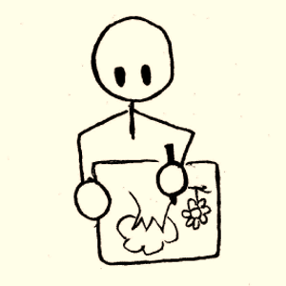


Data Collection Methods
Creative Task:
Visual Drawing in response to Prompts
Reflection:
Explain your drawing
Questionnaire:
Your practice

Slide 7
Participants
Academics from:​
  Visual Arts ​
  Sciences​
  Applied Sciences​
  Linguistics​
  EAP
  SPLD

Slide 8

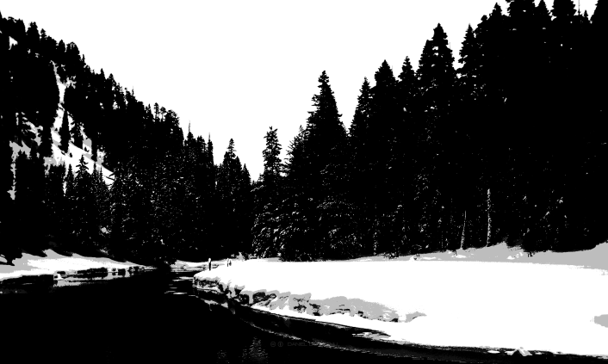
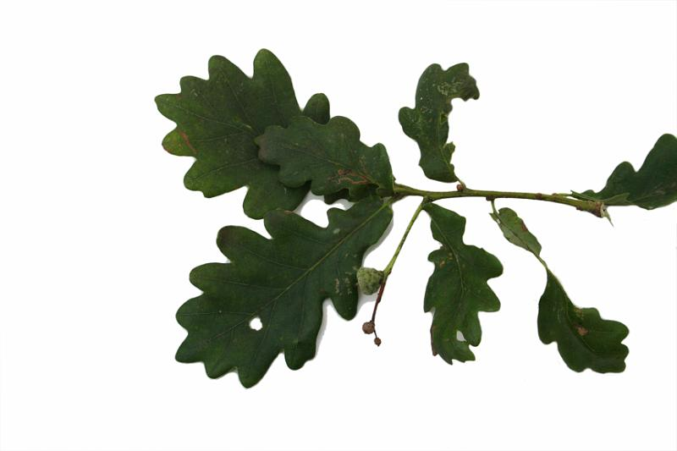
The Prompts
R3
A = Students
L = Institution
V = Self
B = Colleagues

Slide 9
Limitations & Measures
Limitations
Sample Size
Skewed Data
Prompt Interference
Interpreter Bias
Measures
Triangulation
Rotation
Cross Reference

Slide 10


The Prompts
A
L
R1
A = Institution
L = Colleagues
V = Students
B = Self
R2
A = Colleagues
L = Self
V = Institution
B = Students
V
B

Slide 11
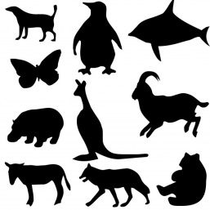


The Impact of Prompts on Visual Response
R1 | R2
Aggression, Duality, Multiplicity, Ubiquity | Duality, Multiplicity, Ubiquity
Hills, Effort, Difficulty | Variation & Difference
Success and Failure Patchiness Creeping | Patchiness, lushness, barrenness, aggression
Openness, access, centrality, distance | Dominance, complexity, distance, lack of access

Slide 12
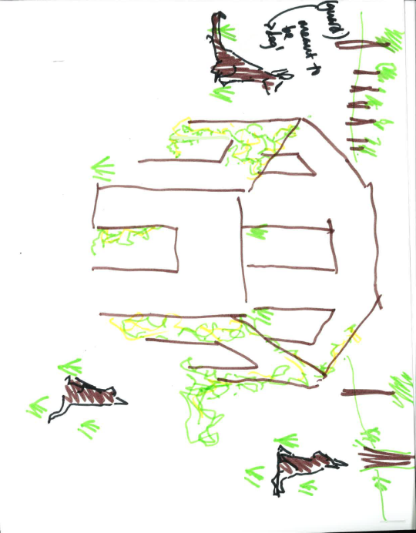
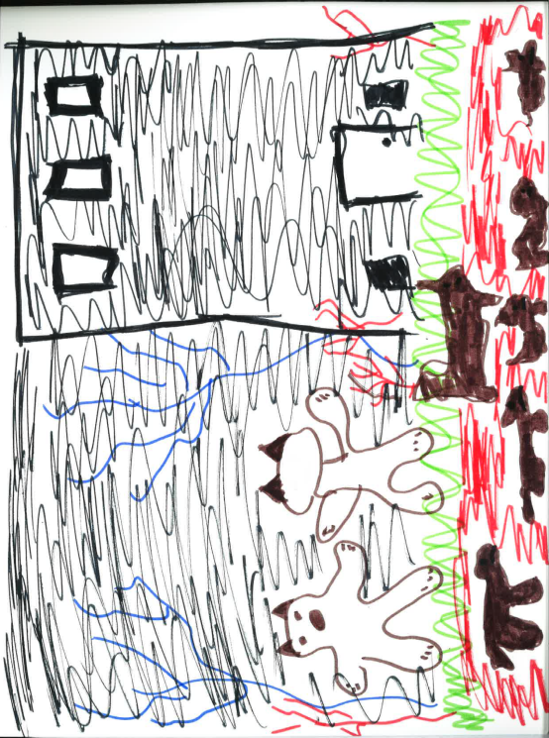
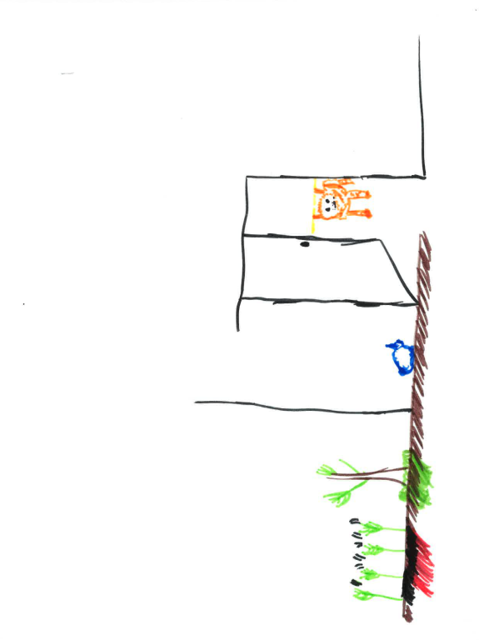
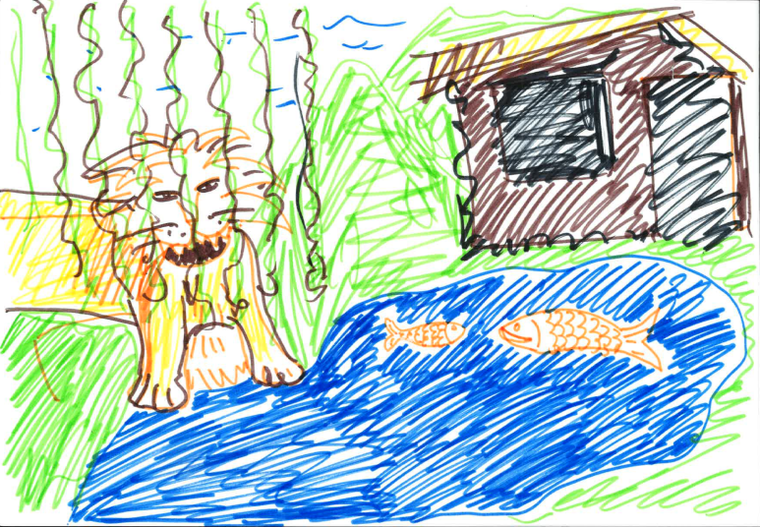
e.g. Buildings: Samples Compared
R1
R2
Notes:
HANDOUT FOR ROTATIONS

Slide 13
Our Visual Findings
The Institution ANIMAL aggression, opposition, ubiquity and obscurity VEGETATION the aggression, lifelessness, lushness, patchiness | The students VEGETATION success & failure, creeping, and ubiquity. BUILDINGS closedness and dominance.
Colleagues LANDSCAPE effort, difficulty, difference. ANIMALS, difference | Self BUILDINGS, centrality and access. LANDSCAPE variance and difference.
Sympathy
Responsibility
Morality

Slide 14
Conclusions from Visuals
Sympathy
Responsibility
Morality
Students are sympathetically viewed.
Staff feel they have responsibility but they are confused, it is difficult and there is variation from colleagues.
Plagiarism occurs mainly because of lack of skill and inadequate handling and not because of moral deficiency

Slide 16
“If yes, which methods do you use?”.

Slide 18

Analysis

Slide 19
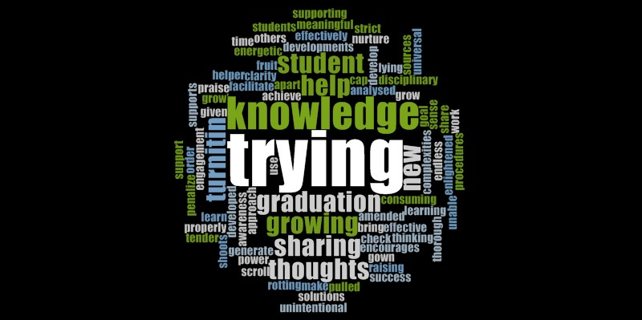
Teaching and Learning (Nvivo)

Slide 20
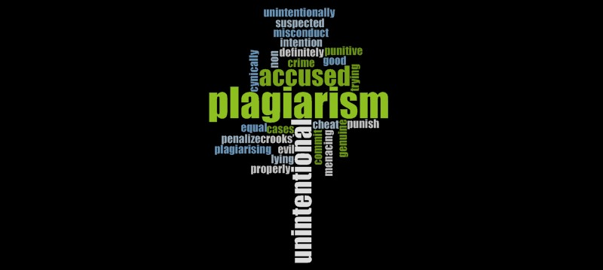
Morality (Nvivo)

Slide 21

In Conclusion
“Not yet have access to ‘words of their own’” – Abasi & Graves (2008:223)
Maintaining home rules is a reaction to a new environment – Harris (1997)

Slide 22
In Conclusion
If policy is interpreted and responded to in different ways “It puts students in a perilous situation , and undermines the efforts of the university community to create a culture of honesty, featuring a set of shared values and shared standards for judging transgression against those values” (Pecorari and Shaw, 2010)

Slide 23
Further Quotes From Reflections
On reflection I doubt academics support students in understanding how work is plagiarised, as much as I have illustrated. My main concern is centred on student learning and their understanding of academic misconduct rather than the act itself.
The green patch in the house is my trying to ‘grow’ some students! IE: nurture, help them to learn how to do it properly, not just penalize when unintentional.
Different stakeholders appear to have a different understanding/idea of what IS PLAGIARISM. From my experience these appear to be quite considerable within the varying stakeholders.
feel that we can do better in communicating what is required.

Slide 24
References
Abasi, A. R., & Graves, B. (2008) Academic literacy and plagiarism: Conversations with international graduate students and disciplinary professors, in The Journal for English for Academic Purposes, 7
Bertram Gallant, T., & Drinan, P. (2006) Organizational Theory and Student Cheating: Explanation, Responses, and Strategies, in The Journal of Higher Education, 77.5
Craig, R. & Dalton, D. (2014) Developing a platform for a culture of honest inquiry and the academic constructiuon of knowledge in first year students, in The international Journal for Educational Integrity, retrieved from www.ojs.unisa.edu.au/journals/index.php/IJEI
Hansen, B.; Stith, D; Tesdell, L. S. (2011) Plagiarism: What's The Big Deal? in Business Communication Quarterly, 74.2
Harris, R. (1997) Overseas Students In The UK, in Overseas Students in Higher Education: Issues in Teaching and Learning (D. MacNamara and R. Harris, eds), London: Routledge
McGowan, U. (2013) Educational integrity: a strategic approach to anti-plagiarism, retrieved from www.Newcastle.edu.au/conference/apeic/paperspdf/mcgowan_0548_edd.pdf
Paldy, L. G. (1996) The Problem Won't Go Away: Addressing The Causes of Cheating, in JCST, 4.6
Pecorari, D. & Shaw, M. (2010) University teachers discussing plagiarism: divided perspectives on teaching writing and shaping a culture of honesty, retrieved from www.plagiarismadvice.org/conference/previous-plagiarism-conferences/4th-plagiarism-conference-2010

