Slide 1
FGM Conference
Compassion…for whom?
Professor Irena Papadopoulos
Middlesex University

Slide 2
Culturally Competent Compassion
(CCC)
What do we mean by Culturally Competent Compassion
CC Compassion…for whom?
My CCC Model
I.Papadopoulos, FGM Conference 20-02-2016, London

Slide 3
CC Compassion…for whom?
Notes:
This was my first question.
Of course one immediately thinks of the young girl who is having it, or has had it, or the young woman who is having a baby. But I am sure that you have heard a lot today from compassionate speakers and much of it was probably about the girl and the woman.
So I was thinking… may be we should consider compassion for others involved in this cultural practice.
How about: the men in those societies, the fathers, the grandfathers, the chiefs and the leaders, those who govern, the prospective husbands and so on.

Slide 4
CC Compassion…for whom?
Those who know me, will probably remember that I often start my presentations with the question:
What does Aristotle say about compassion and all these people?
We will return to Aristotle after you have done some work….

Slide 5
What is
Culturally Competent Compassion
Culturally competent compassion is defined as the human quality of understanding the suffering of others and wanting to do something about it, using culturally appropriate and acceptable healthcare interventions, which take into consideration both the patients’ and the carers’ cultural backgrounds as well as the context in which care is given.
(Papadopoulos 2011)
Cover slide subtitle or date
Notes:
But first let me introduce you to my definition of compassion

Slide 6
CC Compassion…for whom?
Group work (divide into groups of 5)
1) Take turns to answer this question with the first thought that comes into your minds (5 minutes)
What is the first thing that comes to your mind when you think or hear about FGM?
2) Take turns to answer this question with the first thought that comes into your minds (5 minutes)
What are the immediate feelings you have for those involved?
Mother
Grandmother
Person performing the ‘cut’
3) Report back (5 minutes)

Slide 7
CC Compassion…for whom?
Damaris' story
Damaris is from Kenya. She is Muslim. Her grandfather is the chief in her village. She had FGM aged 11. At the time she had no idea what it really was. "I didn’t know where I was going to be cut. I wanted to run, but... they held me back. I was crying so much." Afterwards, Damaris was married off to a much older man who regularly beat her.
As a result of FGM, having sex and giving birth to her baby was agonising. She lived in constant misery and fear, until she found the courage to run away.

Slide 8
CC Compassion…for whom?
FGM is not an issue for women only
In your groups, take 5 minutes to answer:
Can we feel compassionate about the:
Damaris’ mother?
Damaris’ father?
Grandfather?
Husband?
Culture?
Religion?
Society?
Report back (5 minutes)
Notes:
Compassion is not about agreeing with them because that is what they have always done.
The type of compassion required here would be that which challenges constructively by:
Providing information
By educating them about the suffering and the complications
By empowering those who want to support change to have the courage and wisdom to act

Slide 9
CC Compassion…for whom?
Back to Aristotle…

Slide 10
What did Aristotle say about HAPPINESS
Aristotle (384-322 BC)
Compassion is one of the five virtues. A virtue is a habit that is practised and strengthen with use. A virtuous life help us achieve the ‘chief good’ which is Eudaimonia (ultimate happiness)
Courage
Friendship
Forgiveness
Proper self love
Main purpose of living

Slide 11
CC Compassion…for whom?
Aristotle also taught us about the golden mean, the desirable middle between two extremes, one of excess and the other of deficiency
Over compassionate
Harsh and destructive
Wise compassion
Notes:
So what about you and your practice?
How do we educate ourselves and our students to be compassionate and courageous?

Slide 12
THE PAPADOPOULOS MODEL FOR DEVELOPING CULTURALLY COMPETENT COMPASSION IN HEALTHCARE PROFESSIONALS
Cultural Awareness
Cultural Competence
-Self-compassion
-Universal elements of compassion
- Philosophies and religions
-Compassionate assessment
-Compassionate care giving
-Courage and compassion
-Barriers and challenges of compassion
Compassion
Cultural Knowledge
Cultural Sensitivity
-Cultural compassion beliefs
-Cultural similarities and differences in understanding compassion
-Giving and receiving appropriate compassion
-Forming compassionate therapeutic relationships
-Barriers and challenges of compassion
© Irena Papadopoulos 2014

Slide 13
CC Compassion…for whom?
Cultural Awareness
-Self-compassion
-Universal elements of compassion
- Philosophies and religions
If I were a girl/woman who had FGM how does this event in my life make me feel and how has it impacted on the way I treat myself
What are my cultural values on the FGM issue? How do they differ from the people who come from cultures that practise FGM and how do they influence my interaction with them?
Notes:
The client: the young girl, the mother and father?

Slide 14
CC Compassion…for whom?
Cultural Knowledge
-Cultural compassion beliefs
-Cultural similarities and differences in understanding compassion
Do I know enough about the cultural beliefs of the societies which allow/promote the practice of FGM?
Do I and those who practise FGM understand compassion in the same way?
Notes:
What is the role of the woman in those cultures?
How empowered are women in those cultures?
Mothers and grandmothers in the cultures where FGM is practised believe that FGM is a compassionate act. Is this out of fear or love?
If they had a magic wand which could change this custom would they use it?

Slide 15
CC Compassion…for whom?
Cultural Sensitivity
-Giving and receiving appropriate compassion
-Forming compassionate therapeutic relationships
-Barriers and challenges of compassion
How can I best communicate and connect with a mother, who now I know, had taken her 10 year old daughter to have FGM?
Do I have the courage to be compassionate to this mother whose world views and values are different to mine?
How can I gain the trust of
a woman who had FGM and has been admitted with long standing complications and who is scared and embarrassed to speak about her condition?

Slide 16
CC Compassion…for whom?
Cultural Competence
Compassionate assessment
-Compassionate care giving
-Courage and compassion
-Barriers and challenges of compassion
How can I provide care that is competent, compassionate and acceptable?
Are there any professional and /or organisational structures and practices which exclude and /or discriminate about the client?
Do I have the courage to challenge them?
Do I have the wisdom and courage to challenge substandard, insensitive and unkind care which I encounter?
Notes:
Attitudes, the law,

Slide 17
CC Compassion…for whom?
TIME FOR ACTION !
In your groups take 5 minutes to answer these questions AND MAKE A PLAN FOR ONE ACTION …
What can YOU do about FGM?
What will YOU do about FGM?

Slide 18
CC Compassion…for whom?
ActionAid's approach to FGM
Bringing an end to FGM requires changes in attitudes and behaviour at all levels of society. As long as FGM is considered a passage into womanhood and essential for marriage, women will continue to get their daughters cut. Women and girls need to reject FGM, and this will only be possible if men and boys also oppose the practice and openly declare that they will marry girls who have not been cut.
For this to happen, individuals - both men and women - need to have the confidence to voice their opinions, and communities must openly discuss the issue and together decide to abandon the practice. This openness is also key to ensuring that girls and their families who reject FGM do not experience negative social consequences as a result.

Slide 19
CC Compassion…for whom?
To achieve this, we provide direct support to women and girls who have escaped mutilation, through our rescue centres, safe houses and girls clubs. To bring about change from within, we talk openly with women, men, boys and girls about the damaging impacts of FGM, as well as influential members of the community, such as traditional elders and religious leaders.
We work closely with each of these groups and offer them training in the specific skills they need to speak out and influence others, so that eventually whole communities say no to FGM.

Slide 20
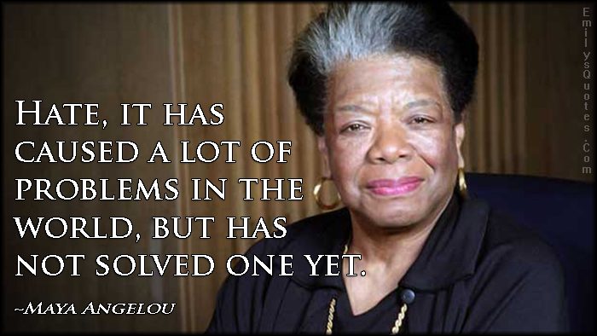
CC Compassion…for whom?

Slide 21
Thank you r.papadopoulos@mdx.ac.uk

Slide 22
CC Compassion…for whom?

Slide 23
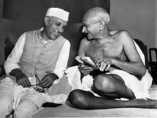
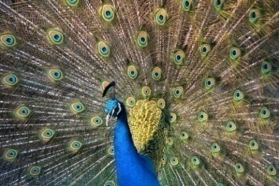
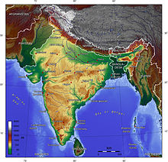
Compassion and Virtuous life
Aristotle (384-322 BC) | Buddha (563-483 BC) | Hinduism (2000 BC)
Compassion is one of the five virtues. A virtue is a habit that is practised and strengthen with use. A virtuous life help us achieve the ‘chief good’ (main purpose of living) which is Eudaimonia (ultimate happiness) | Non-discrimination Right insight/understanding Compassion Happiness | Being compassionate is the most essential element of good Karma. Good Karma leads to good life after death which leads to ‘good’ reincarnation. Progressive ‘good’ reincarnations lead to ultimate spiritual happiness => NIRVANA
Aristotle (384-322 BC) | Buddha (563-483 BC) | Hinduism (2000 BC)
Compassion is one of the five virtues. A virtue is a habit that is practised and strengthen with use. A virtuous life help us achieve the ‘chief good’ (main purpose of living) which is Eudaimonia (ultimate happiness) | Non-discrimination Right insight/understanding Compassion Happiness | Being compassionate is the most essential element of good Karma. Good Karma leads to good life after death which leads to ‘good’ reincarnation. Progressive ‘good’ reincarnations lead to ultimate spiritual happiness => NIRVANA

