Slide 1
Researching the Pedagogy
Dr. Pat Cartney,
JSWEC, 2015

Slide 2
Underpinning ideas
Space to think together about the current changes in the landscape of higher education
To reflect on the impact of changes in social work education
To explore threats and potential offered by current fluidity
Identify possible impact on research – practice tributaries & chance to reconfigure this relationship

Slide 3
Exploring the higher education context
A battle is currently being fought in relation to the future of university education across the globe.
Changes in the financial position of universities are the most obvious site for such a ‘call to arms’.
Browne Review & Students at the Heart of the System – transformed financial relationship between student and state.
Substantial crease in tuition fees & withdrawal of teaching budget as part of government’s austerity measures.
Global austerity situation for higher education.

Slide 4
Global economic forces are argued as leading to the ‘marketisation’ of higher education (Molesworth, Scullion and Nixon, 2010) and the growth of private universities.
The increased provision of University League Tables and student satisfaction surveys have emerged and grown in importance within this context.
Collini suggests that ‘Vice – chancellors now keep as nervous an eye on league tables as do football managers’ (2012 : 17).
Global economic forces are argued as leading to the ‘marketisation’ of higher education (Molesworth, Scullion and Nixon, 2010) and the growth of private universities.
The increased provision of University League Tables and student satisfaction surveys have emerged and grown in importance within this context.
Collini suggests that ‘Vice – chancellors now keep as nervous an eye on league tables as do football managers’ (2012 : 17).

Slide 5
You said – we did
Students rebranded as consumers rather than scholars.
Higher education is increasingly reconceptualised as an individual as opposed to a social good.
New market orientation and economic drivers are also contributing to changes in the internal and external workings of the university and raising more fundamental questions about what a university is, or could be in 2015.

Slide 6
Different voices
Higher education currently exists in a contested space where different voices are sounding about the conflicting purposes of academic education and what constitutes the essence of being a university.
Some of the possibly unintended consequences of our marketisation may still be unknown.

Slide 7
Changes in social work education
Taking place within broader fluid overarching context of changes within higher education.
Step Up, Front Line, Think Ahead, Teaching Partnerships- challenging the primary site of location of social work educ.
What does this mean? What are the threats and the opportunities for us?

Slide 8
Potential Threats…many…
The de- professionalisation of social work – training not education, course too short etc?
Impact of academic capitalism – students and lecturers
Lack of critique – employer voice too loud
Lack of outside reflective space for learning
Co-productive co-learning with other students in different sites reduced
Breadth and depth of learning challenged.

Slide 9
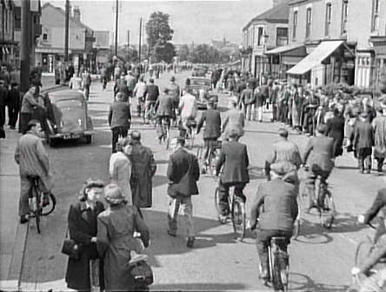
So…
Is it all over for social work education – time to go home?

Slide 10
Fluidity not fixed context….
Does the re-positioning of social work education offer opportunities for a different relationship with practice research?
Might we move further towards practice near rather than practice distant research?
Education more in practice – reclaiming ‘practice wisdom’ as knowledge source.

Slide 11
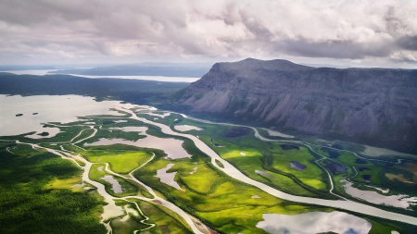
Range of tributaries in the research – practice divide
To own our professional background and experience explicitly.
Knowledge as co-production – with practitioners, service users and students.
Explore messy knowledge – fine grained, in depth
Draw upon different methodologies (Froggett and Briggs, 2012)

Slide 12
Reconfiguring pedagogy as research
Work with our students to research their understandings about practice
Research with rather than on students
Mutual interconnectivity – teaching research mindedness in the process (Cartney, 2013)

Slide 13
Moving forward
Looked at context, arguments against and for undertaking pedagogic research.
Argued this space is contested – multiple voices and agendas.
Opens up possibilities for us.

Slide 14
References
Browne, J. (2010) Securing a sustainable future for higher education: An independent review of higher education funding and student finance. Accessed 13th October 2010 from www.independent.gov.uk/browne-report
Cartney, P. (2013) Researching pedagogy in a contested space, British Journal of Social Work, doi.10.1093/bjsw/bct151
Collini, S. (2012) What are universities for? London, Penguin
Froggett, L. & Briggs, S. (2012) Practice –near and practice distant methods in human sciences, Journal of Research Practice, 8 (2) Article M9

Slide 15
House of Commons Innovation, Universities, Science & Skills Committee (2009) Students and Universities: Eleventh report of session 2008 -9. Accessed 15th December 2010 from http://www.publications.parliament.uk/pa/cm200809/cmselect/cmdius/170/170ipdf
Molesworth, M., Scullion, R., & Nixon, E. (2010) The marketisation of higher education and the student as consumer. London, Taylor Francis

Slide 16
Presentation based in part on
Cartney, P. (2012) Researching pedagogy in a contested space
Thesis available via Middlesex Research Repository.

